Slide 1
Second Year B. Tech. Advanced Data Structures (CS228)
By
Dr. Pramod D. Ganjewar
Senior Assistant Professor,
School of Computer Engineering,
MIT Academy of Engineering, Alandi(D.),Pune

Slide 2
Unit – 1 Trees Tree Basics and its Terminology

Slide 3
Tree Definition
Tree data structure may be defined as-
Tree is a non-linear data structure which organizes data in a hierarchical structure and this is a recursive definition.
OR
A tree is a connected graph without any circuits.
OR
If in a graph, there is one and only one path between every pair of vertices, then graph is called as a tree.

Slide 4
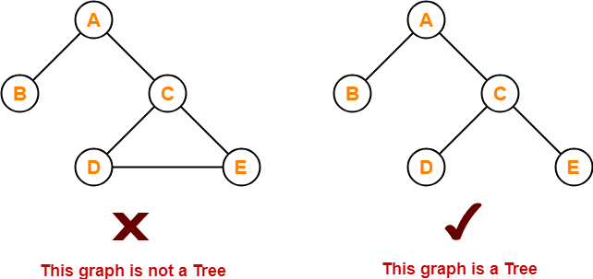
Tree Examples

Slide 5
Tree Properties
The important properties of tree data structure are-
There is one and only one path between every pair of vertices in a tree.
A tree with n vertices has exactly (n-1) edges.
A graph is a tree if and only if it is minimally connected.
Any connected graph with n vertices and (n-1) edges is a tree.

Slide 6
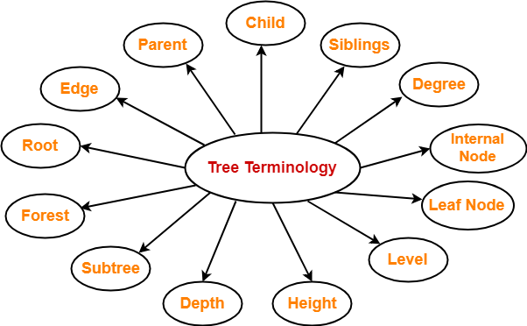
Tree Terminology
The important terms related to tree data structure are-

Slide 7
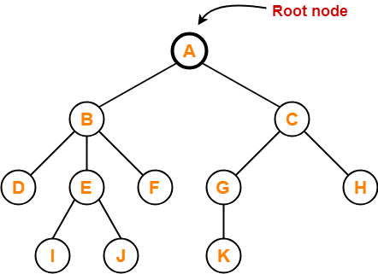
Tree Terminology
Root
The first node from where the tree originates is called as a root node.
In any tree, there must be only one root node.
We can never have multiple root nodes in a tree data structure.
Here, node A is the only root node.

Slide 8
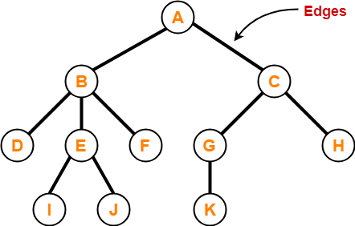
Tree Terminology
Edge-
The connecting link between any two nodes is called as an edge.
In a tree with n number of nodes, there are exactly (n-1) number of edges.

Slide 9
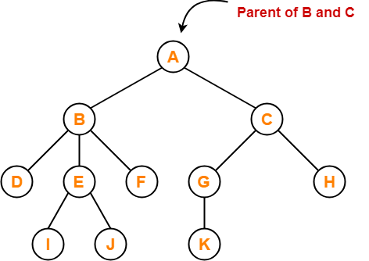
Tree Terminology
Parent-
The node which has a branch from it to any other node is called as a parent node.
In other words, the node which has one or more children is called as a parent node.
In a tree, a parent node can have any number of child nodes.
Here,
Node A is the parent of nodes B and C
Node B is the parent of nodes D, E and F
Node C is the parent of nodes G and H
Node E is the parent of nodes I and J
Node G is the parent of node K

Slide 10
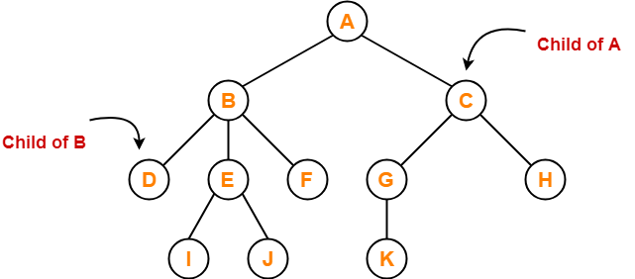
Tree Terminology
Child
The node which is a descendant of some node is called as a child node.
All the nodes except root node are child nodes.
Here,
Nodes B and C are the children of node A
Nodes D, E and F are the children of node B
Nodes G and H are the children of node C
Nodes I and J are the children of node E
Node K is the child of node G

Slide 11
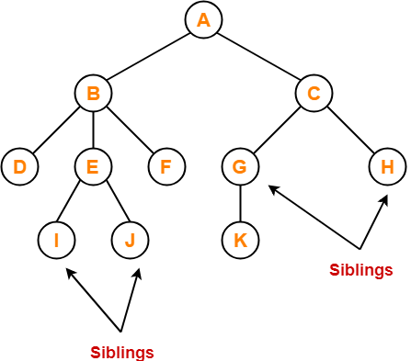
Tree Terminology
Siblings
Nodes which belong to the same parent are called as siblings.
In other words, nodes with the same parent are sibling nodes.
Here,
Nodes B and C are siblings
Nodes D, E and F are siblings
Nodes G and H are siblings
Nodes I and J are siblings

Slide 12
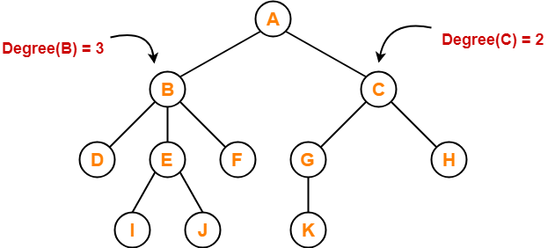
Tree Terminology
Degree
Degree of a node is the total number of children of that node.
Degree of a tree is the highest degree of a node among all the nodes in the tree.
Here,
Degree of node G is 1.
Degree of node A,C,E is 2.
Degree of node B is 3.
Degree of node D, F, H, I, J and K is 0.
Hence Degree of Tree is 3.

Slide 13
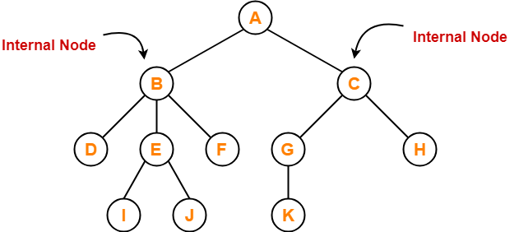
Tree Terminology
Internal Node
The node which has at least one child is called as an internal node.
Internal nodes are also called as non-terminal nodes.
Every non-leaf node is an internal node.
Here, nodes A, B, C, E and G are internal nodes.

Slide 14
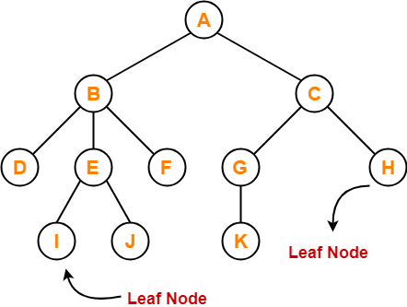
Tree Terminology
Leaf Node
The node which does not have any child is called as a leaf node.
Leaf nodes are also called as external nodes or terminal nodes.
Here, nodes D, I, J, F, K and H are leaf nodes.

Slide 15
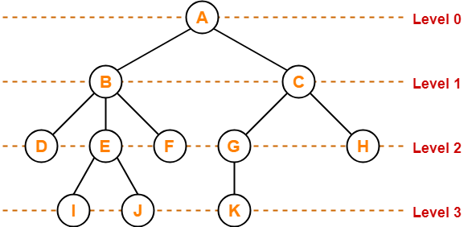
Tree Terminology
Level
In a tree, each step from top to bottom is called as level of a tree.
The level count starts with 0 and increments by 1 at each level or step

Slide 16
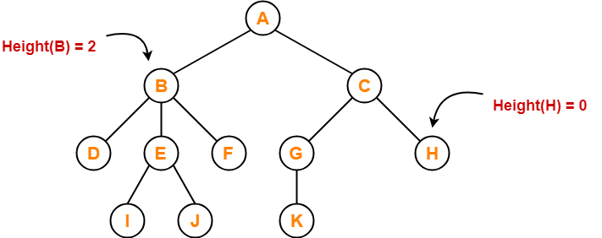
Tree Terminology
Height
Total number of edges that lies on the longest path from any leaf node to a particular node is called as height of that node.
Height of a tree is the height of root node.
Height of all leaf nodes = 0
Here,
Height of node E and G is 1.
Height of node A is 3
Height of node B,C is 2
Height of node D, F, H, I, J and K is 0.

Slide 17
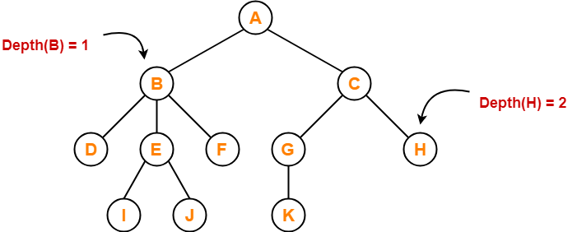
Tree Terminology
Depth
Total number of edges from root node to a particular node is called as depth of that node.
Depth of a tree is the total number of edges from root node to a leaf node in the longest path.
Depth of the root node = 0
The terms “level” and “depth” are used interchangeably.
Here,
Depth of node A is 0.
Depth of node B and C is 1.
Depth of node D, E, and G is 2.
Depth of node I, J and K is 3.

Slide 18
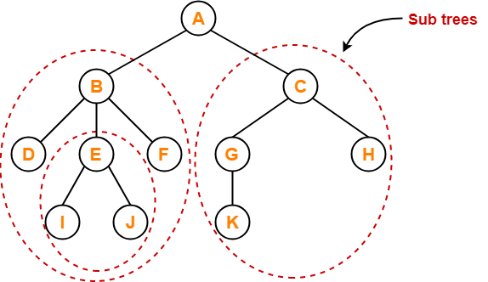
Tree Terminology
Subtree
In a tree, each child from a node forms a subtree recursively.
Every child node forms a subtree on its parent node.

Slide 19
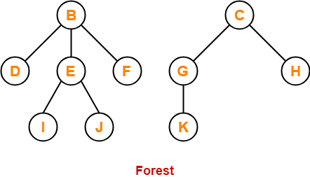
Tree Terminology
Forest
A forest is a set of disjoint trees.

Slide 20
Thank You

